Slide 1

+ Executive Summary
Key Findings
“State tax systems appear to act as long-run incentive environments that shape economic and demographic adaptation.”
Incentives operate even when not explicitly designed
States show different long-run adaptation patterns
Findings are directional, not causal
Notes:
Jeff - 30 second
We were asked to help policymakers understand whether tax systems do more than raise revenue.
In other words, do long-run state tax structures act as implicit incentive systems that “train” the economic composition and demographic evolution of states over time.
Our finding is that tax systems appear to function as long-run incentive environments. These incentives aren’t always intentional, but they persist, and over time states adapt to them in different ways.
We’re not claiming cause-and-effect — but the patterns are strong enough to inform policy thinking.”

Slide 2
+ Client Problem:
Decision-Making Under Uncertainty
Policymakers must make long-run decisions before economic evidence is settled.
Challenges:
Policy updates often precede research consensus
Economic theory is contested and value-laden
Incentives already shapes behaviour without observation
Notes:
Lina: (1 min)
“From a policymaker’s perspective, decisions can’t wait for perfect evidence.
Tax policies are implemented years before the research community agrees on their effects. At the same time, incentives operate continuously — whether or not they’re explicitly acknowledged.
This creates a gap: we lack tools that help observe how existing policy environments are actually shaping outcomes over time.”

Slide 3
+ Dynamic Perspective:
A System View of Policy
Tax structures create incentives, and economies adapt to them gradually
Economic Structure & Demograp-hics
Tax Structure
Firms & Household Responses
Incentives
Notes:
Jeff(?) (1 min)
We approach this as a system, not a one-off policy change.
Tax structures shape relative payoffs. Firms and households respond gradually. Over time, these responses accumulate and reshape the economic mix and population structure of a state.
To do this, we model a state’s tax structure as the average environment firms experienced over a over the prior three years, measured two years before we observe economic outcomes.
This is a slow process — which is why it’s often hard to see using traditional short-term evaluation methods.

Slide 4
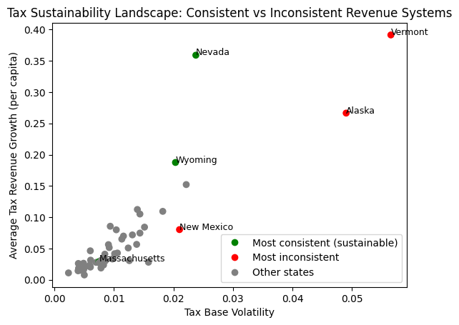
+ How We Observe Incentives:
Observing Unknown Collective Factors
We measure incentives using what states actually collect, not what policies intend:
Revenue sources grouped into broad categories
Focus on persistent, long-run pattern
Suspending assumptions about “good” or “bad” taxes.
Notes:
Lina: (1 min)
Rather than debating tax intent or statutory design, we focus on what states actually collect revenue from over time.
In practice, outcomes differ widely: the tax base as a share of GDP varies by more than 3× across states, and tax base volatility differs by over 5× between the most and least consistent systems.
Revenue composition shows which activities are being consistently taxed — and therefore implicitly rewarded or discouraged.
States with the most consistent revenue systems draw roughly two-thirds of revenue from broad, diversified bases, while more inconsistent states rely heavily on narrow or externally driven sources that can account for 25–40% of total revenue in some years.
This allows us to observe incentives directly, without taking a position on economic theory or policy goals.

Slide 5
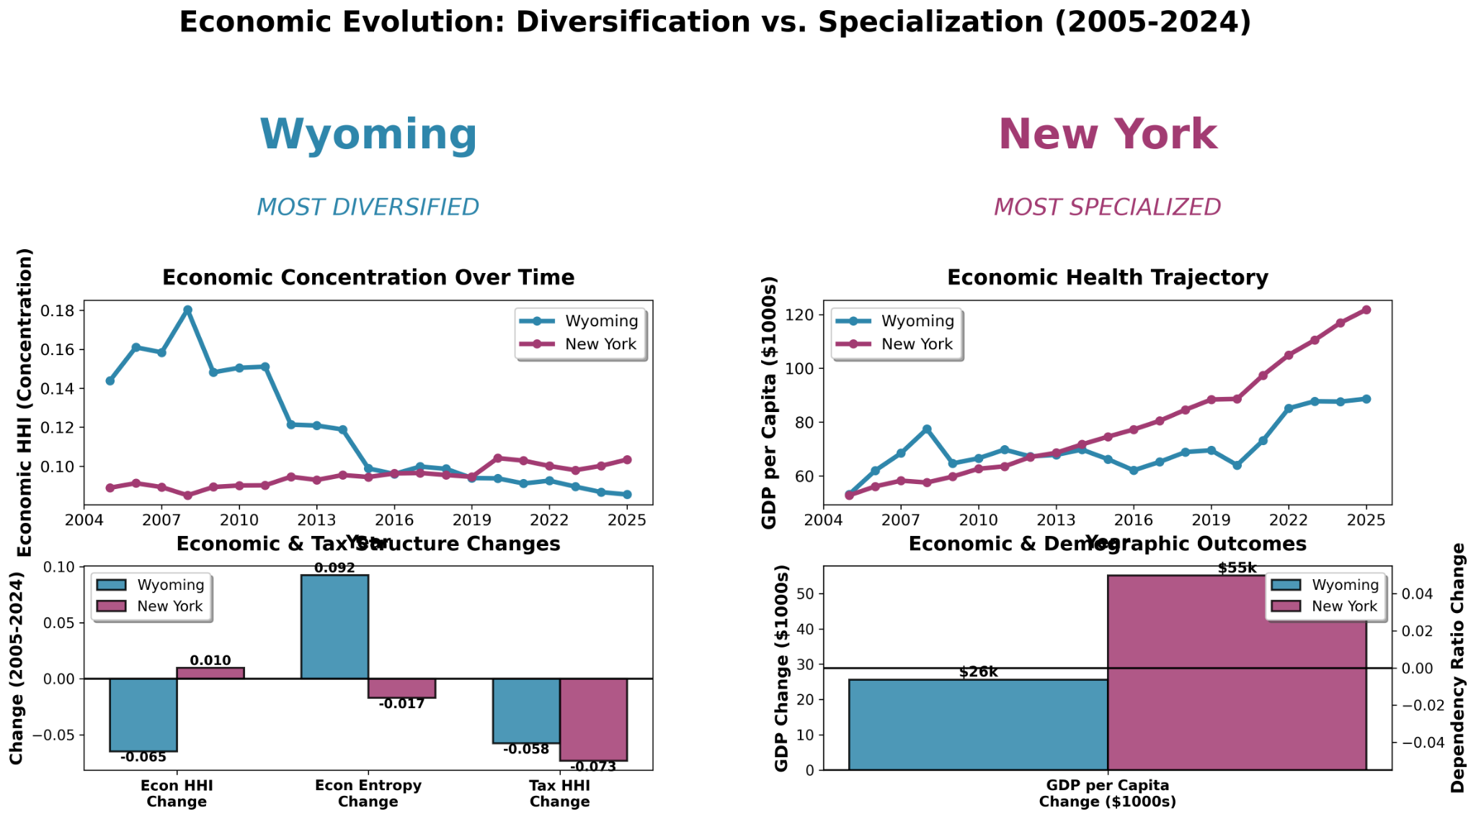
+ How We Observe Adaptation:
Evolving from Growth to Progress
We focus on how states change over time, not just how large or rich they are:
Economic structure (sector mix, concentration)
Diversification vs specialization
Demographic drift (aging, dependency)
Notes:
Sachin (?) (1 min)
“Instead of focusing on GDP levels or short-term growth, we look at structural change.
Are state economies becoming more concentrated or more diversified? Are populations aging faster?
These are outcomes that matter for long-run resilience and fiscal sustainability — and they align closely with policy goals.”

Slide 6
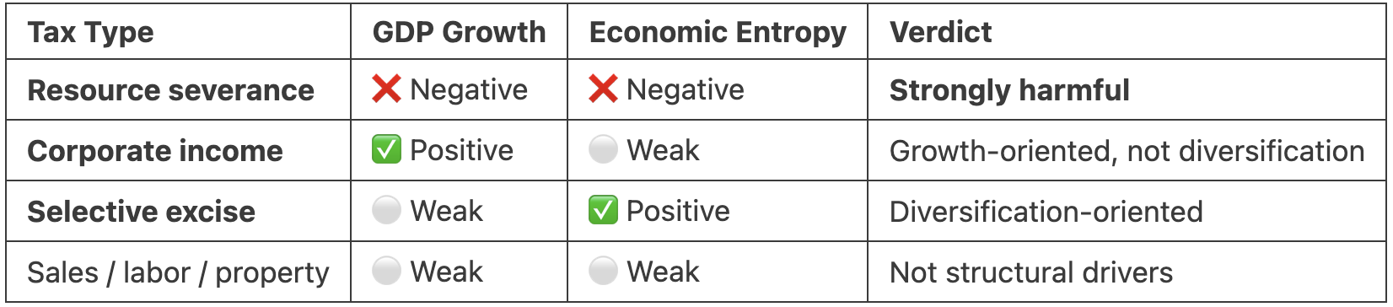
+ How We Assess Directionality:
Working Towards Resilience
We compare groups of similar states and observe divergence after shared national events:
Group states by similar tax structures
Observe differences after national shocks
Look for consistent patterns, not precision
Notes:
Jeff - 45 sec
To assess whether incentives tend to come before adaptation, we compare groups of similar states with different tax structures.
When national events affect everyone at once, we observe whether these groups diverge over time.
This doesn’t eliminate all uncertainty, but it helps us reason about directionality in a practical way.
Our preliminary findings suggest that states that rely on resource-based tax revenues systematically drift toward slower economic growth and lower diversification, while states anchored in corporate and selective excise tax bases show stronger growth or more diversified economic structures.
In other words, it’s what a state taxes—not how much—that quietly trains its economy over time.

Slide 7
+ When Results Are Mixed:
Absence as Information
Knowing where incentives do not appear to matter is also valuable.
Why is it important?
Some incentives align with outcomes
Others show weakness or no association
Narrows the range of plausible policy narratives
Notes:
Kolbe - 45 sec
“An important point is that mixed or null results are still informative.
In a complex system, learning where incentives don’t seem to drive outcomes helps policymakers avoid overconfidence and misdirected interventions.
This reduces decision risk by narrowing the set of plausible policy stories.
An example would be economic concentration or spread across fields which our preliminary findings suggested can either increase or decrease depending on the tax type

Slide 8
+ Framework for Policymakers:
Navigating Uncertainty
This framework adds a diagnostic lens to the policymaker’s toolkit.
Enables | Does Not
Observe long-run incentive alignment Compare policy environments Surface misalignments early | Prescribe tax changes Claim cause-and-effect Replace detailed policy studies
Notes:
Jeff (?) (1 min)
“We see this as a diagnostic tool.
It helps policymakers observe whether existing policies appear aligned with long-run objectives — before deciding what to change.
It doesn’t replace theory or experiments, but it adds a new perspective that’s especially useful early in the policy process.”
“In short, this framework helps policymakers observe what existing systems are already teaching the economy — before deciding what they want to teach next.”

Slide 9






+ Appendix:
Meet Team 37
Jeffrey Allen
UMSI - MADS
Data Scientist / Product Leader
Lina Al-Rawahi
UMSI - MADS
Research Analyst
Kolbe Sussman
UMSI - MADS
Researcher/
U-M ADVANCE
Sachin Murthy
UMSI - MADS
Data Scientist
Ushasree Jakilinki
UMSI - MADS
Project Repo
Notes:
Kolbe (?) - 15-30 sec
Thank you for listening to our proposal, please check out our project repo for more information and detailed analysis results
h
ttps://github.com/jeffallen007

Slide 10
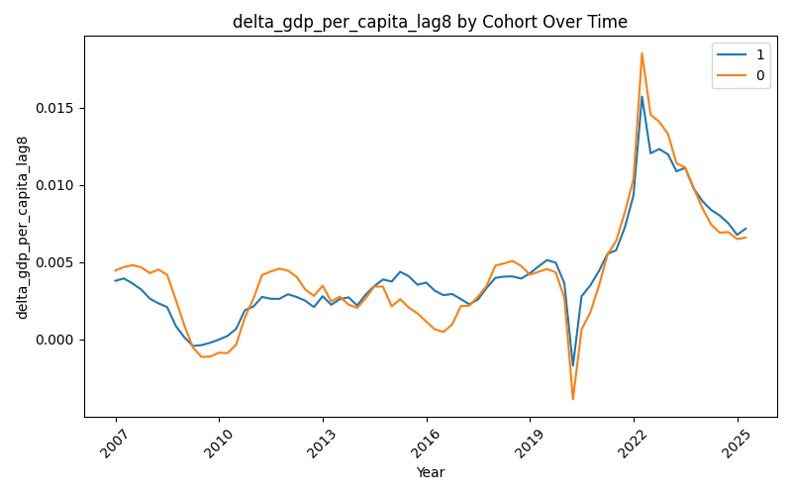
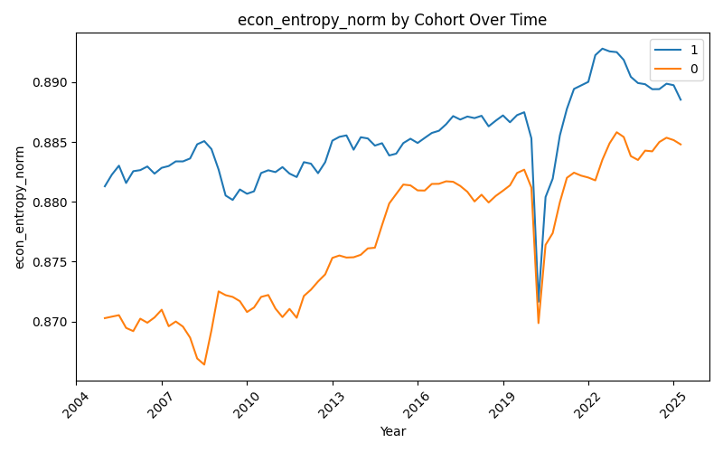
+ How We Assess Directionality:
Working Towards Resilience
We compare groups of similar states and observe divergence after shared national events:
Group states by similar tax structures
Observe differences after national shocks
Look for consistent patterns, not precision
Change in GDP per Capita (lag)
Economic Entropy
Notes:
Kolbe - 45 sec
“To assess whether incentives tend to come before adaptation, we compare groups of similar states with different tax structures.
When national events affect everyone at once, we observe whether these groups diverge over time.
This doesn’t eliminate all uncertainty, but it helps us reason about directionality in a practical way.”
higher tax exposure (lagged) is associated with GDP per capita growth
Indicates exposure correlates with sectoral diversification
Bottom line is: Outcomes like GDP growth and entropy are consistently positively associated with higher tax exposure.

Slide 11
+ For In Depth Research
Key Takeaway
“Persistent tax incentives influence how state economies adapt over years, rewarding some structures while locking others into low-growth paths.”
Initial Findings:

